Slide 1


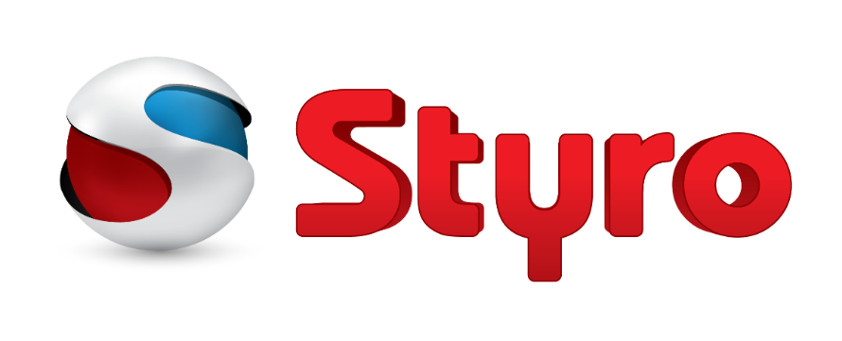

EXPANDED POLYSTYRENE SOLUTIONS
STYRO EIFS SYSTEMS
Notes:
Please follow the next tips in order to be able to watch our video:
Open as read-only -> Select (enable content) option -> view it as a slide show

Slide 2
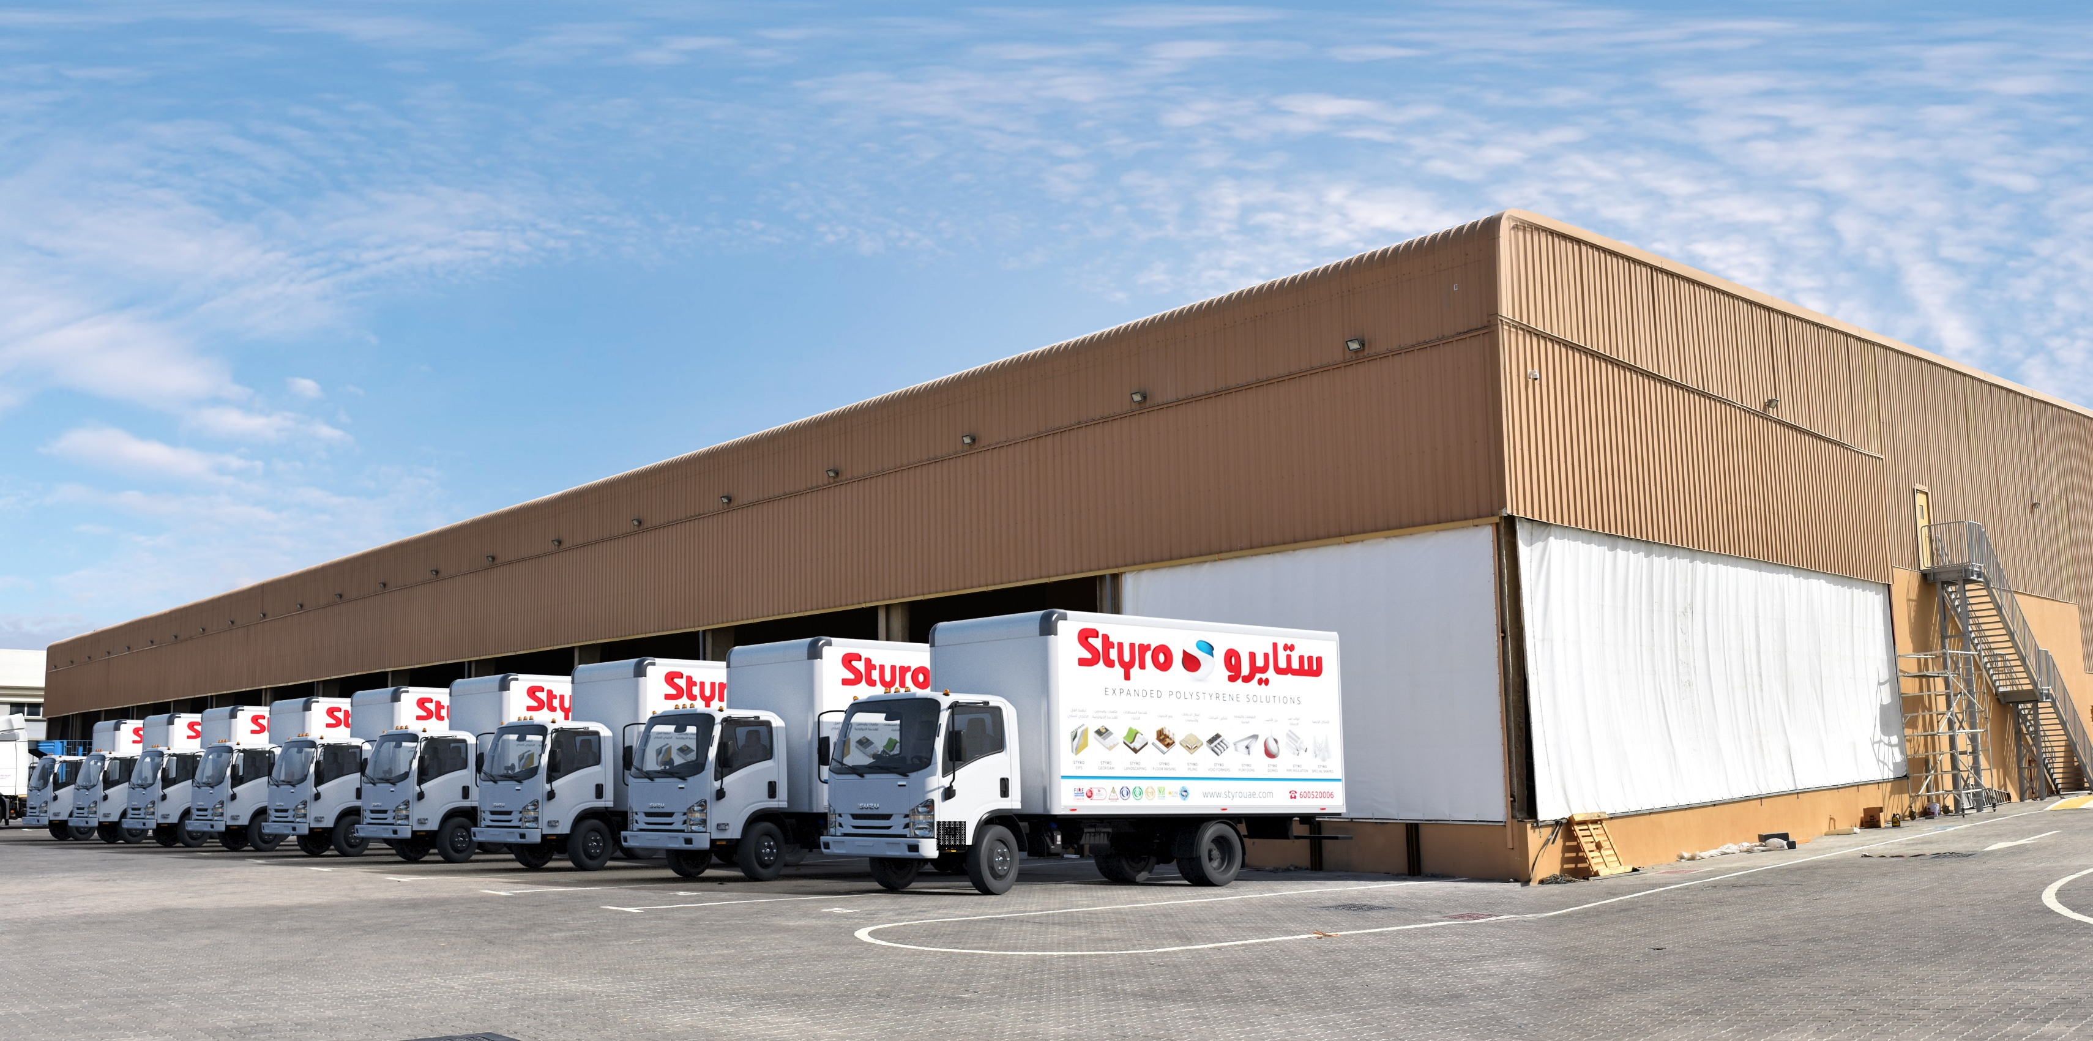
STYRO Insulations Mat. Ind. (L.L.C)
Established in January 2000
STYRO provides complete integrated insulation and construction solutions for residential, commercial infrastructural projects. Our services cover consultation, engineering and project management.
For more than 20 years our products and applications were involved in prestigious projects not limited to insulation but also landscaping, bridges and nuclear plant projects.

Slide 3
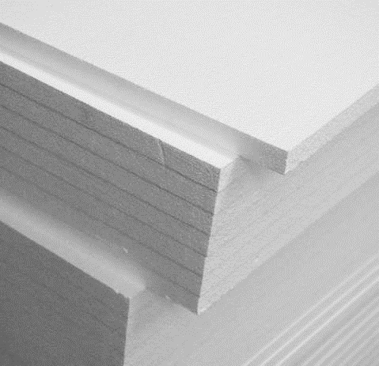
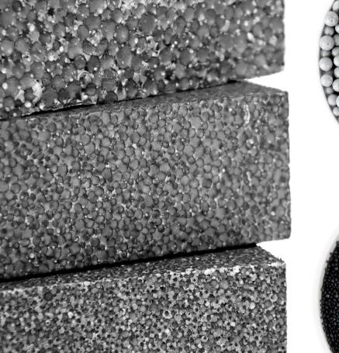
STYRO Products
STYRO EPS
STYRO Graypor
STYRO EPS is the white colour product used mainly in construction, void filling, packing/packaging and landscaping applications.
It is the preferred choice for decoration projects in our STYRO EIFS Systems.
STYRO Graypor is made from Neopor raw material produced by BASF Germany. It is a sustainable insulation introduced by STYRO 10 years ago.
It is the preferred choice for heat insulation projects in our STYRO EIFS Systems.

Slide 4
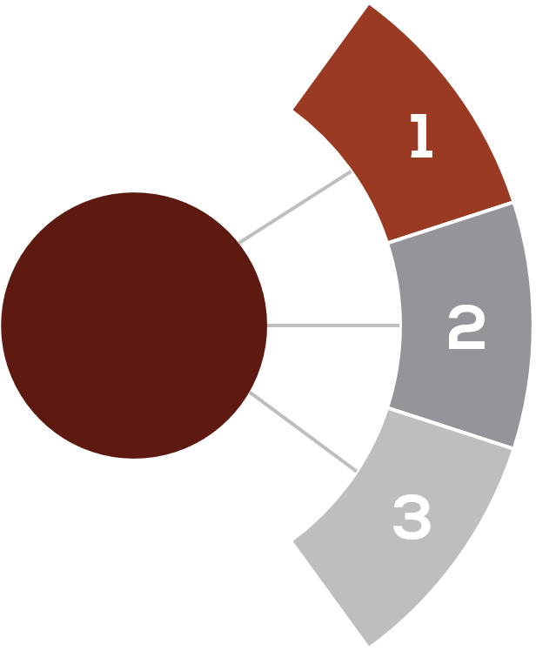
STYRO EIFS SYSTEMS
EI (External Insulation)
ED (External Decoration)
ID (Insulation & Decoration)
MM (Mix Media)
STYRO SYSTEMS
STYRO SOFFIT SYSTEMS
STYRO Soffit Insulation with Fibre Glass
STYRO Soffit Insulation with Cement Board
STYRO Soffit Insulation with Aluminium Foil
STYRO Soffit Insulation with
STYRO GEO TECH SYSTEMS
STYRO Landscaping Systems
STYRO Floor Raising Systems
STYRO Ramp Systems
STYRO Void Filling Systems

Slide 5
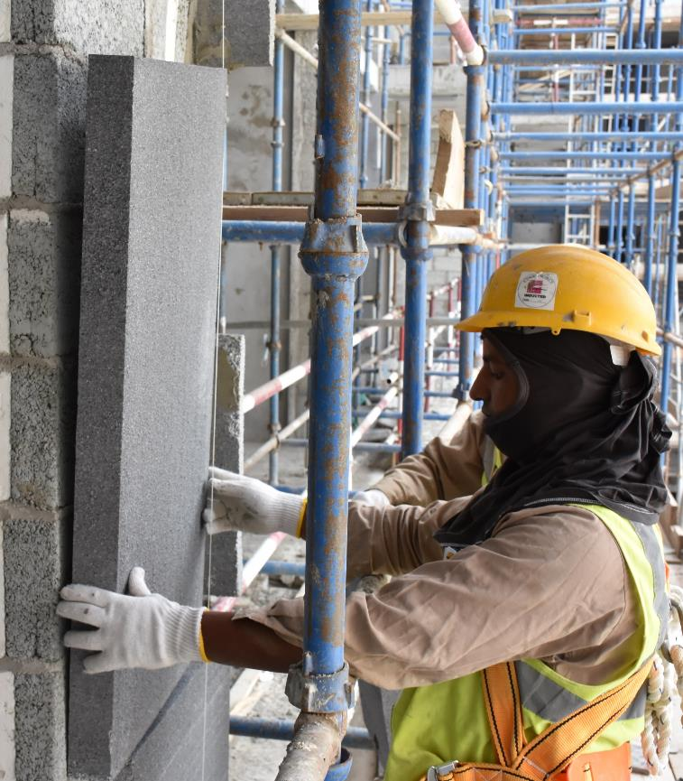
What is STYRO EIFS System?
STYRO EIFS system is based on using STYRO Expanded Polystyrene as an insulation / decoration material. It is a sustainable and lightweight type of cladding system that provides exterior walls with an insulated finished surface with waterproofing characteristics.
It is an integrated composite material system that is applied at site depending on the project requirements.

Slide 6
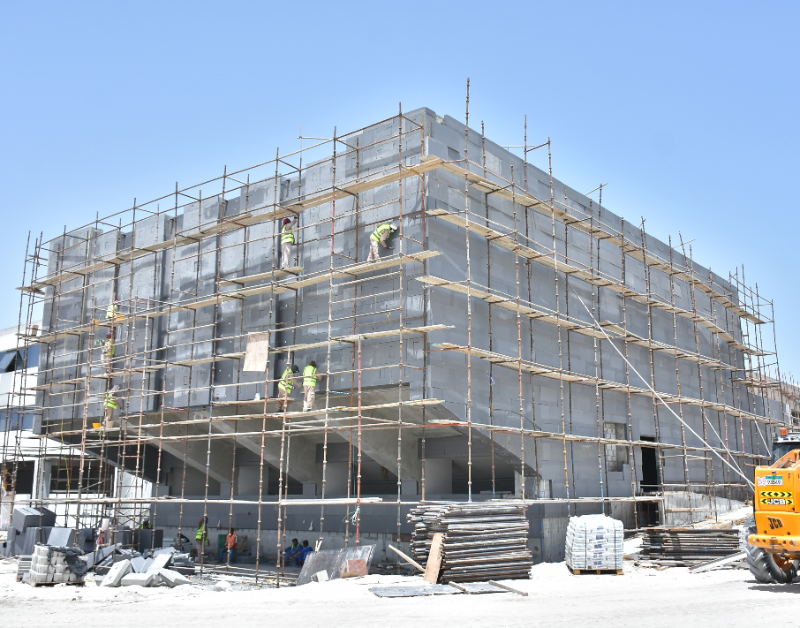
Why STYRO EIFS Systems?
1. The best insulation system with infinite decorations and designs for enveloping all buildings and villas.
2. Sustainable, lightweight and energy-saving cladding system with great environment-friendly characteristics.
3. Easily applied on brick walls, concrete, cement boards, steel frames and other media.
4. Powerful system for new buildings and villas in addition to renovating and retrofitting of old ones.
5. A crack free system that wraps buildings and villas hence omitting all thermal bridges

Slide 7
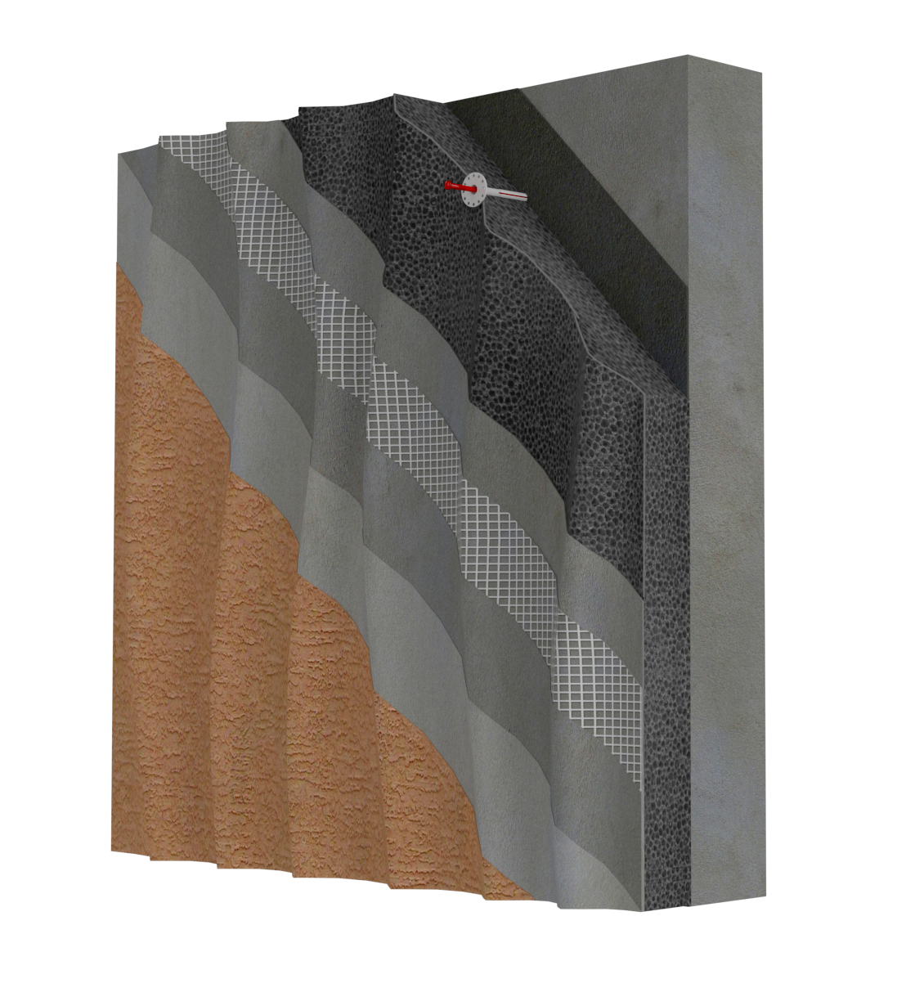
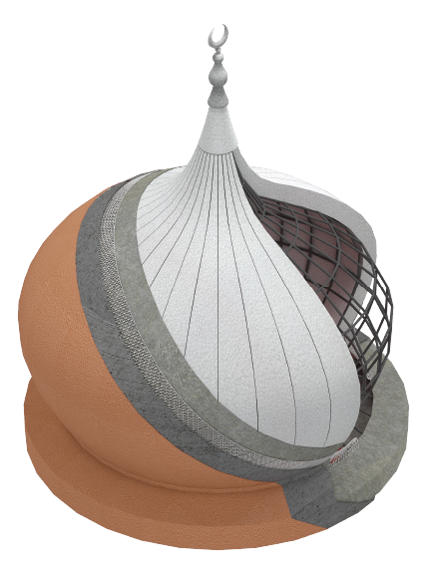
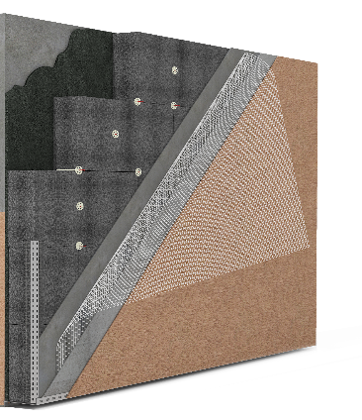
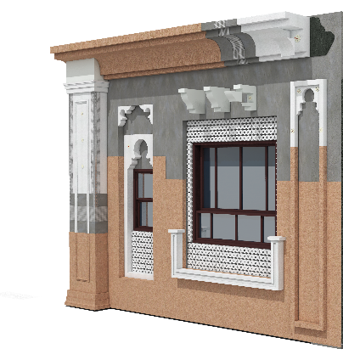
Types of EIFS Systems
STYRO EIFS Systems
1. EI (External Insulation)
2. ED (External Decoration)
3. ID (Insulation & Decoration)
4. MM (Mix Media)

Slide 8
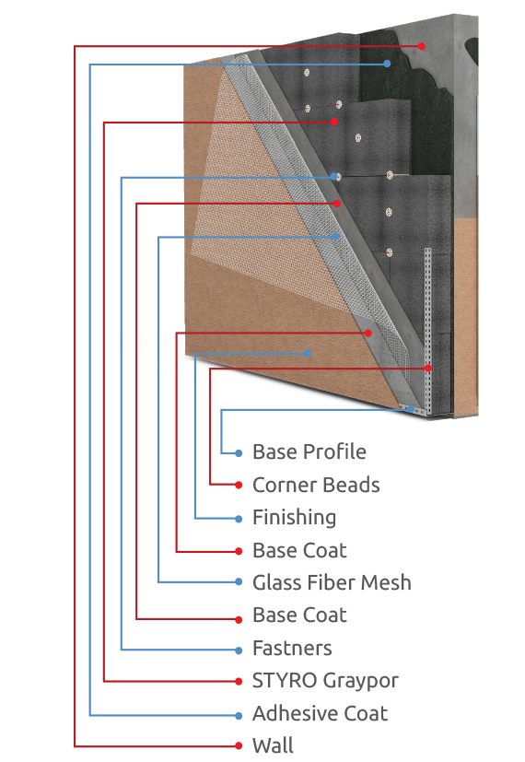
1
STYRO EIFS System
EI (External Insulation)

Slide 9
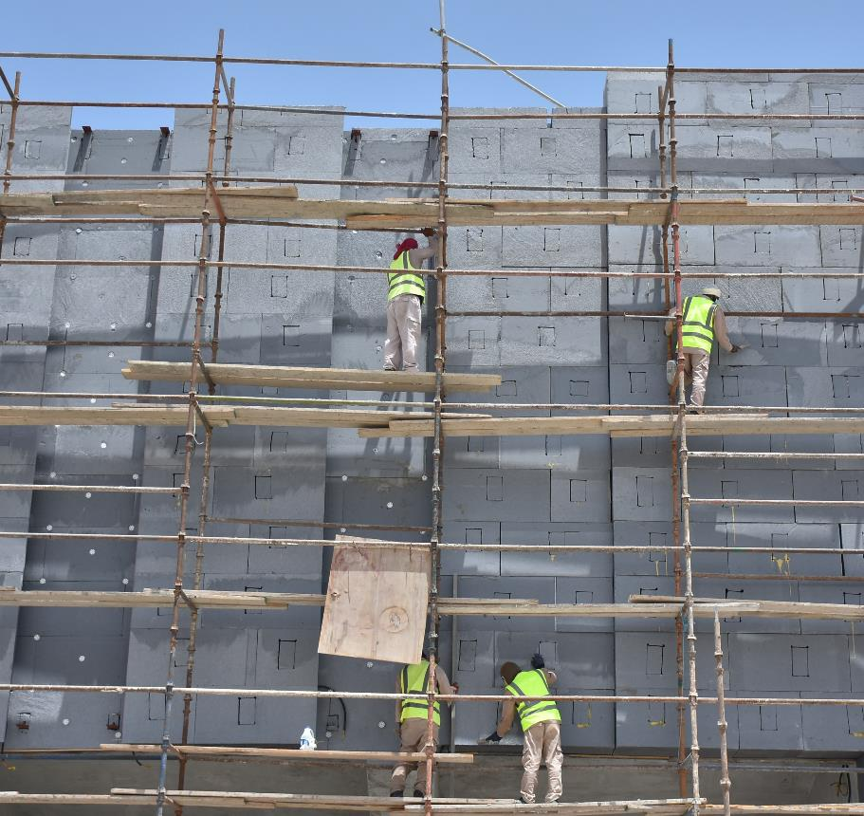
EI (External Insulation) Features:
Lightweight system that does not put pressure on foundations.
Good insulation with long term R value
Stable, Easy and fast to apply
Good dimension stability
Accredited by Civil Defense
Eco friendly and Sustainable

Slide 10
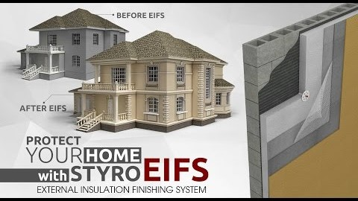
Notes:
Please follow the next tips in order to be able to watch our video:
Open as read-only -> Select (enable content) option -> view it as a slide show

Slide 11
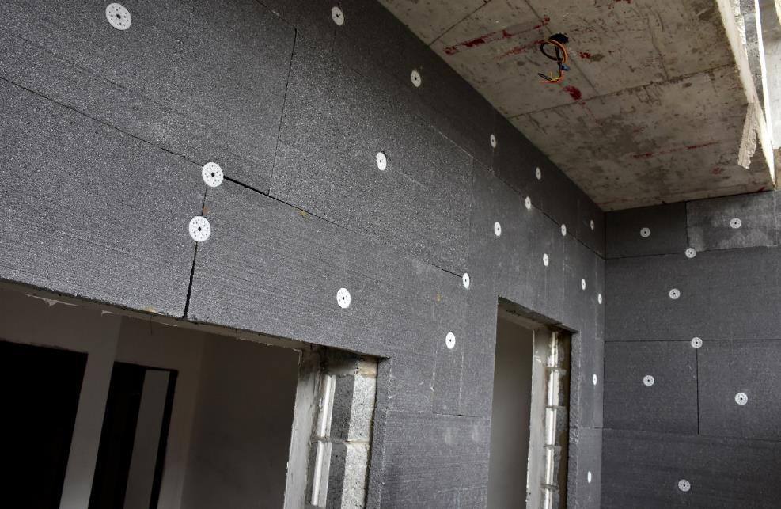
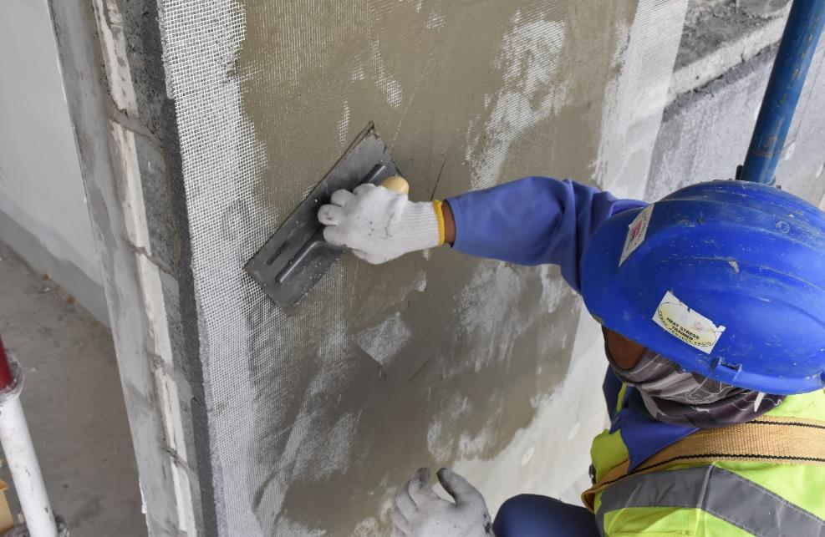
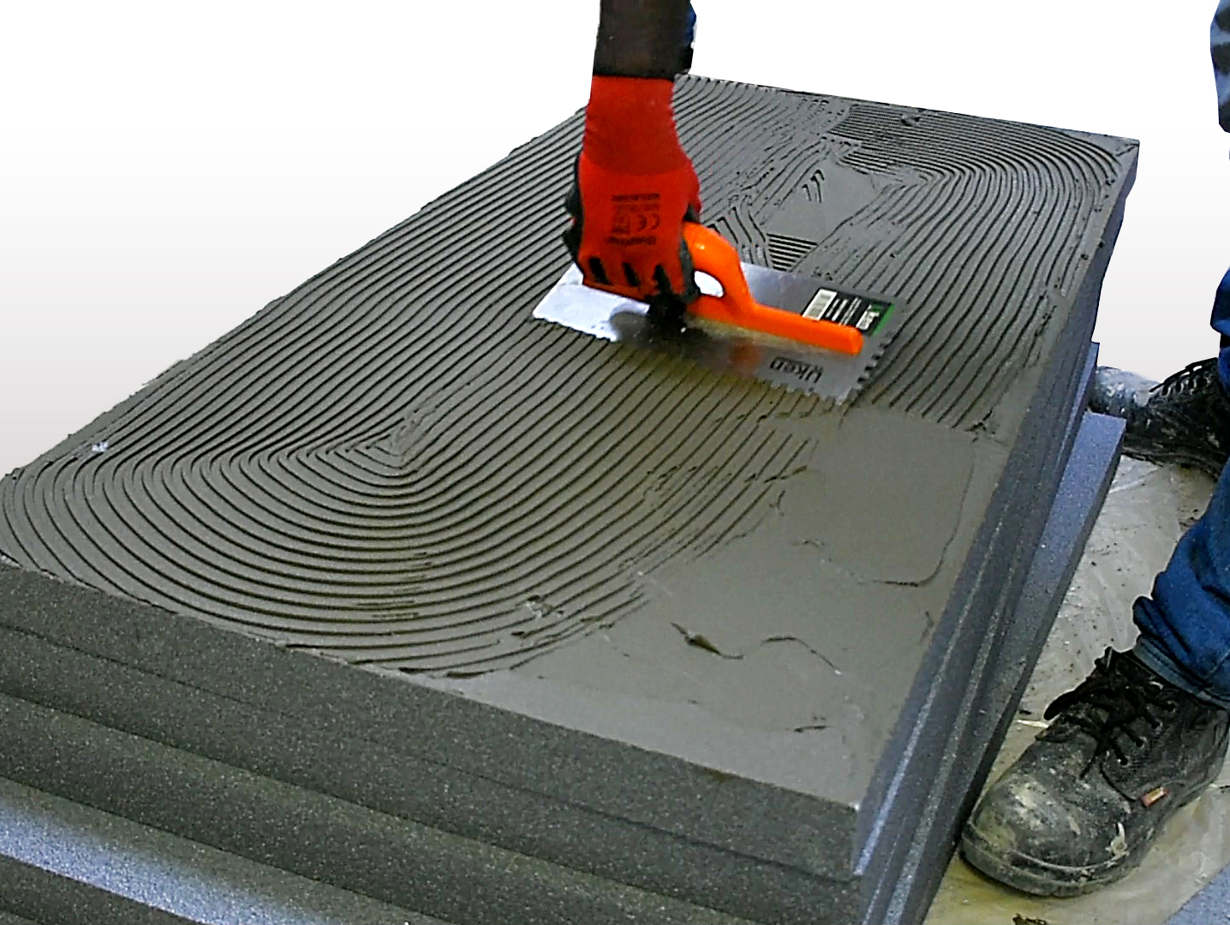
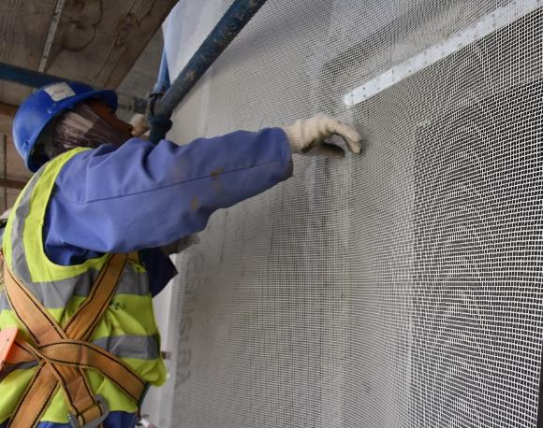
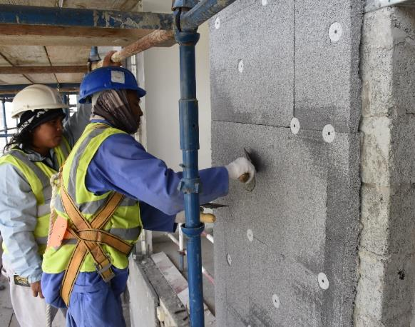

Slide 12
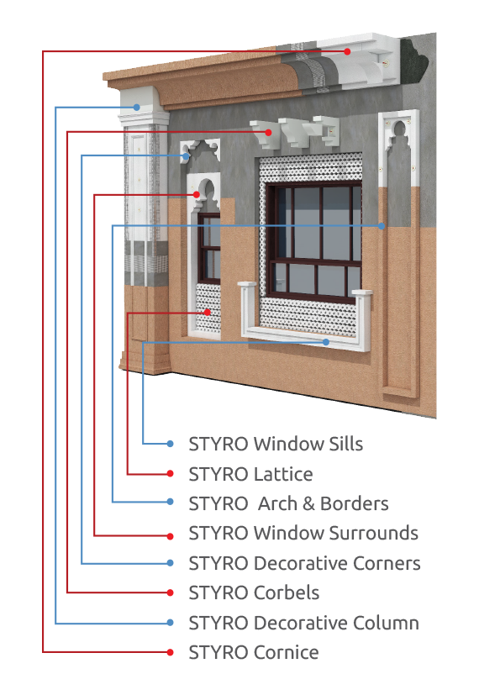
2
STYRO EIFS System
ED (External Decoration)

Slide 13
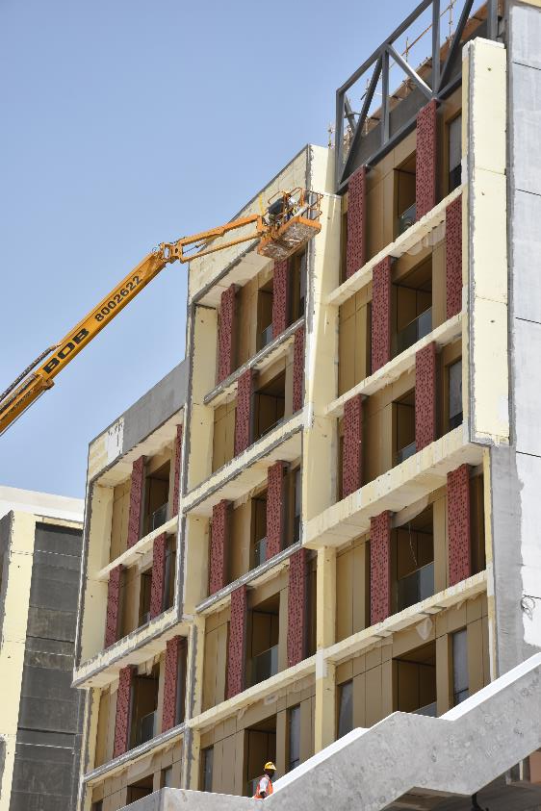
ED (External Decoration) Features:
Lightweight and easy to install, not like GRC which is heavy and complicated during installation
Easy to handle at site
Fast to apply
Unlimited shapes and designs
Cost effective
Eco friendly

Slide 14
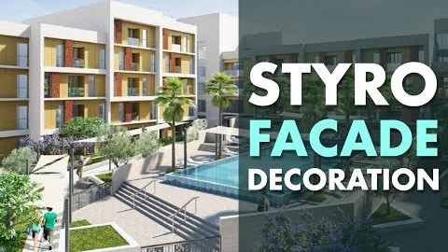
Notes:
Please follow the next tips in order to be able to watch our video:
Open as read-only -> Select (enable content) option -> view it as a slide show

Slide 15
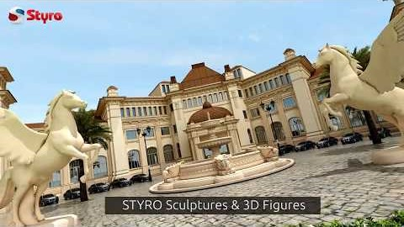
Notes:
Please follow the next tips in order to be able to watch our video:
Open as read-only -> Select (enable content) option -> view it as a slide show

Slide 16
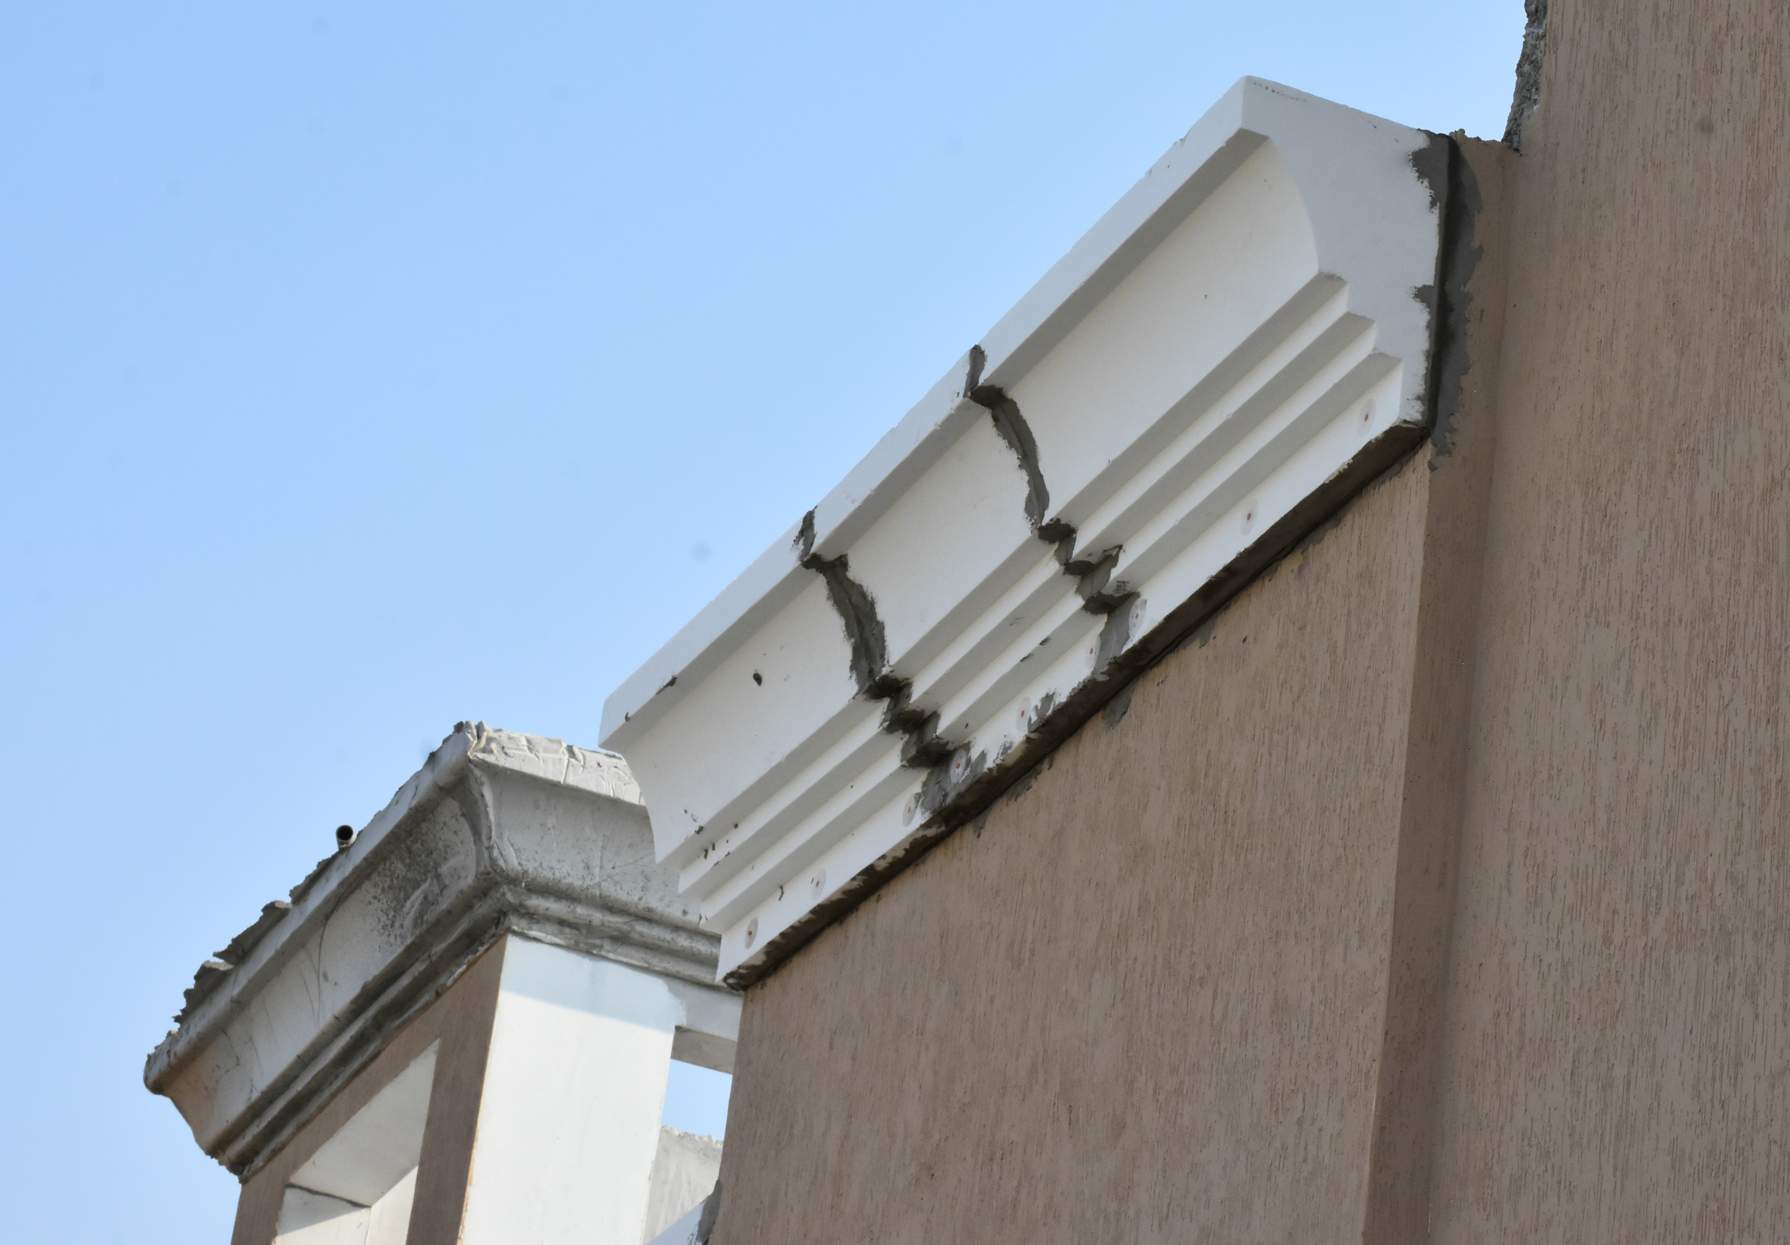
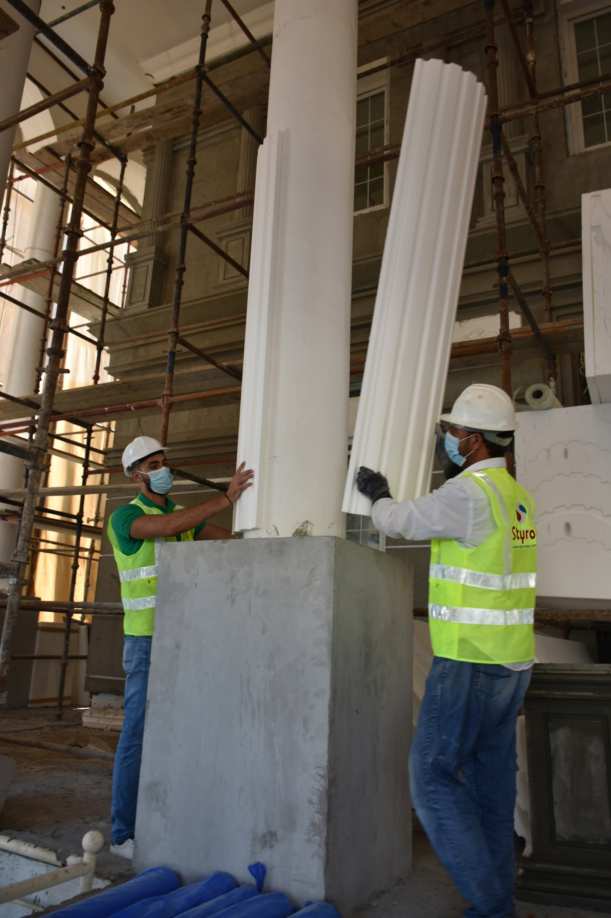
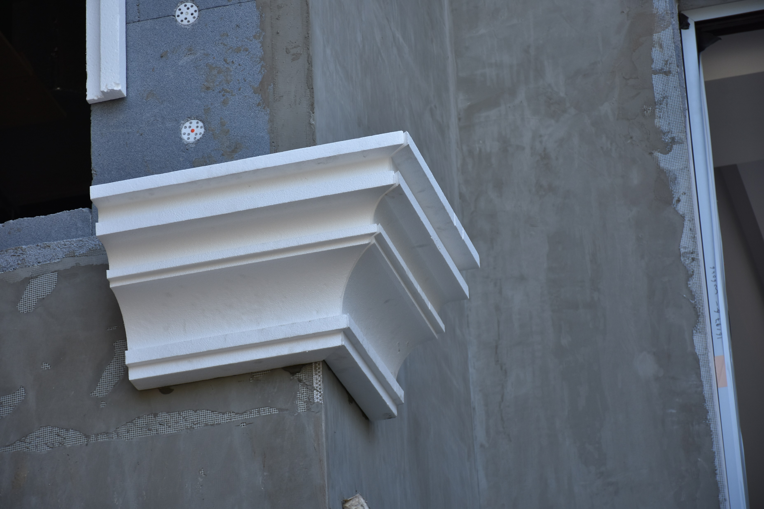
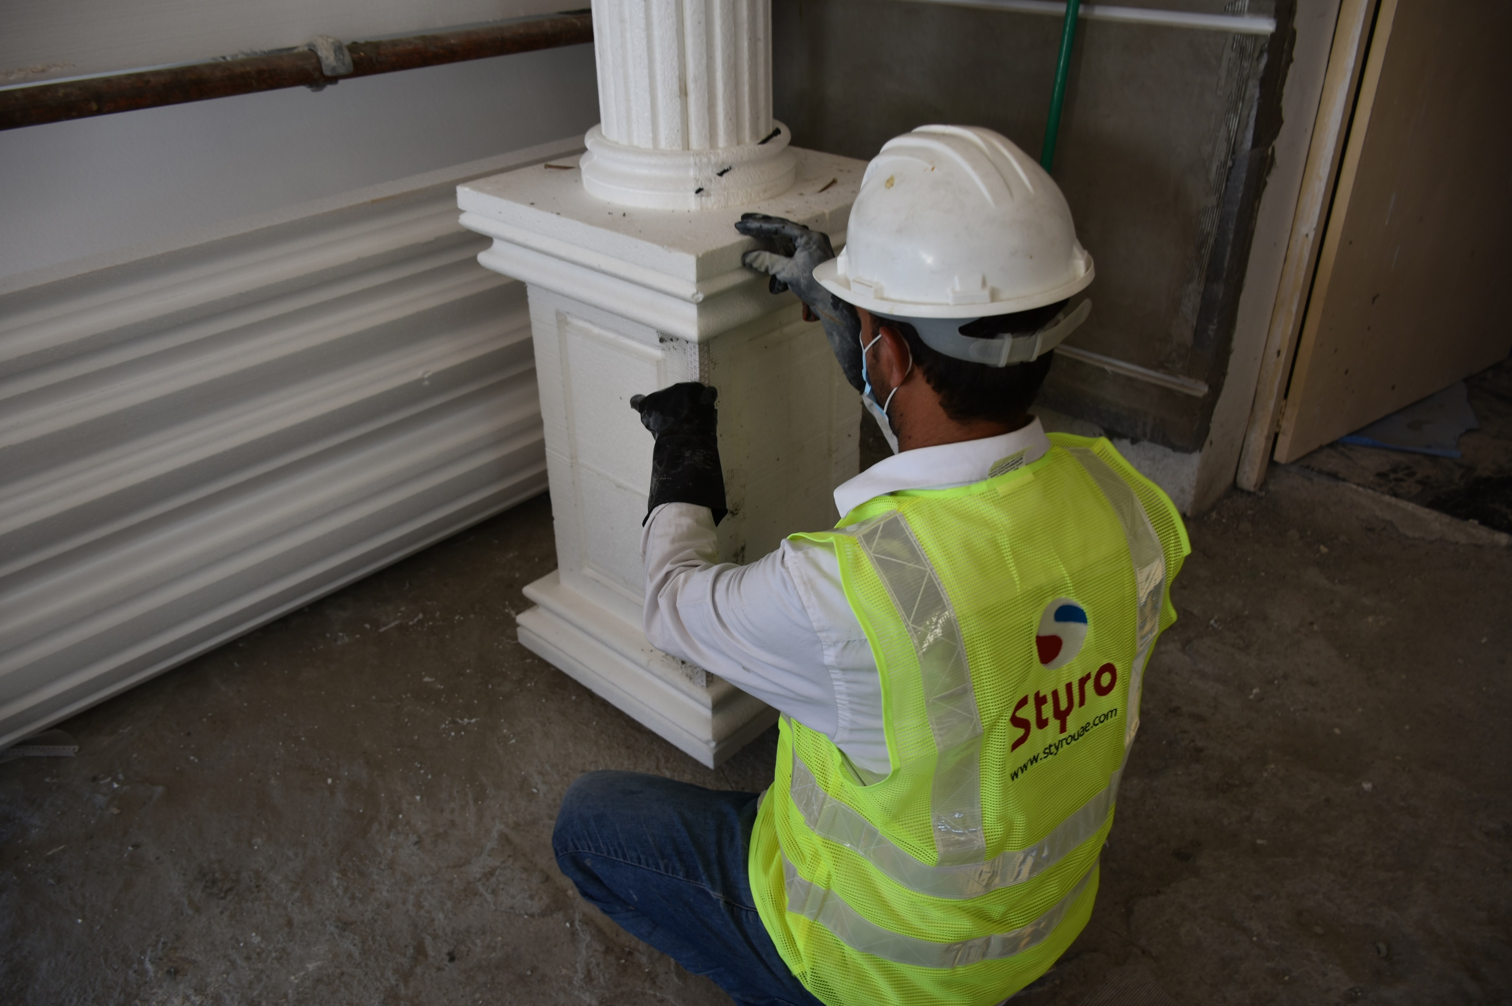
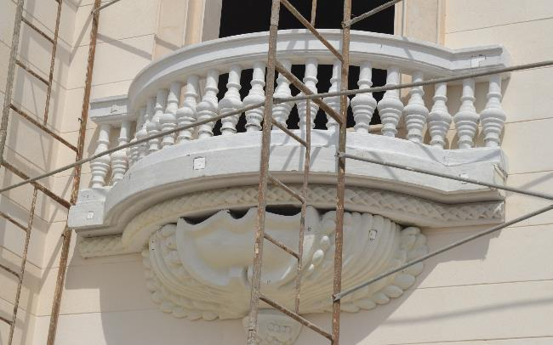

Slide 17
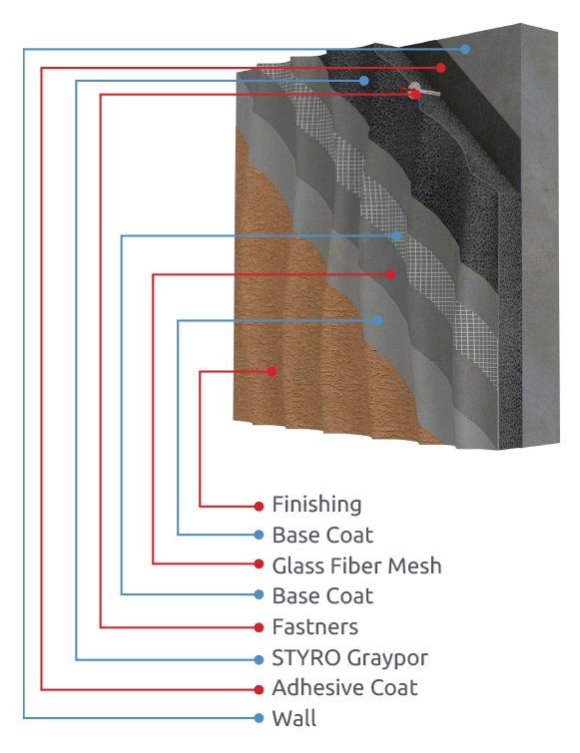
3
STYRO EIFS System
ID (Insulation & Decoration)

Slide 18
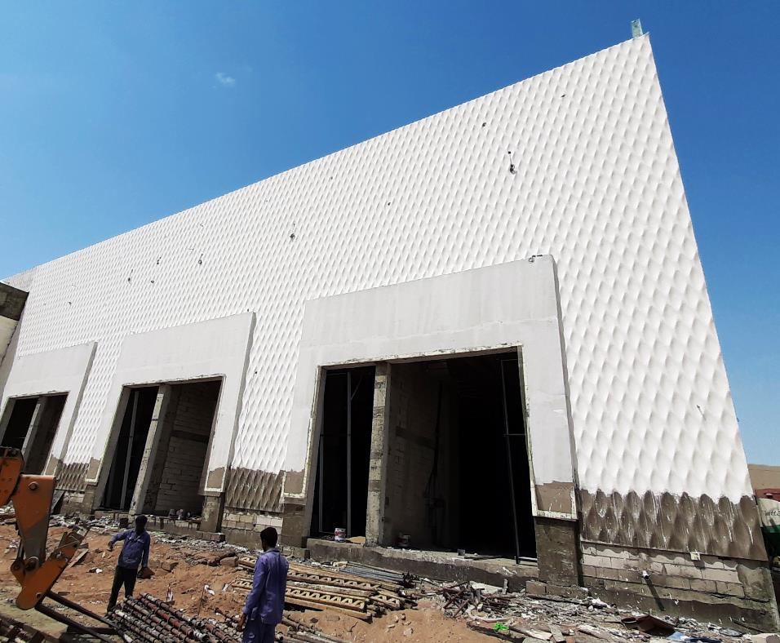
ID (Insulation & Decoration) Features:
STYRO EIFS provides insulation and decoration solutions in one system
Lightweight and easy to design
Good insulation with long term R value
Unlimited shapes and designs
Stable, Easy and fast to apply
Eco friendly

Slide 19
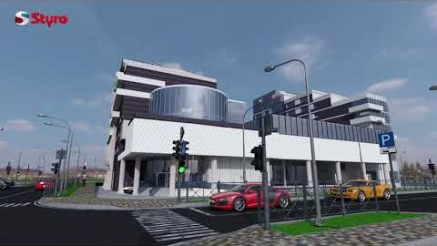
Notes:
Please follow the next tips in order to be able to watch our video:
Open as read-only -> Select (enable content) option -> view it as a slide show

Slide 20
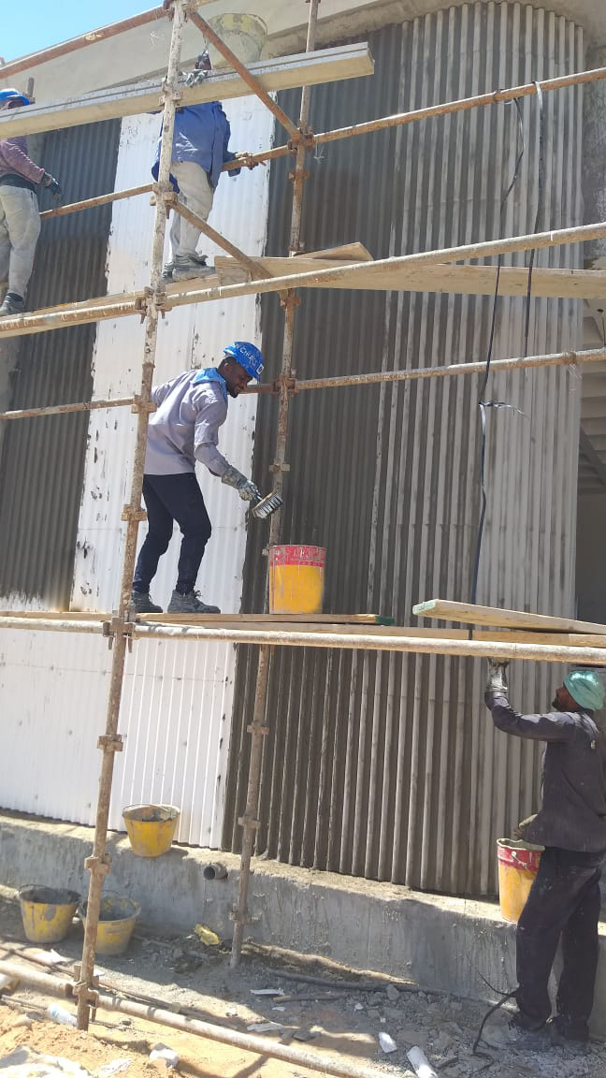
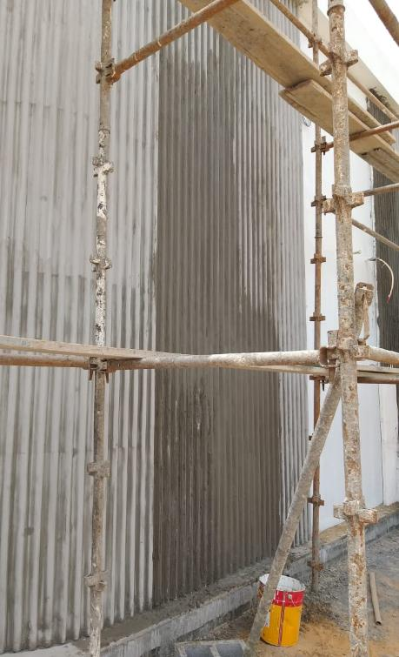
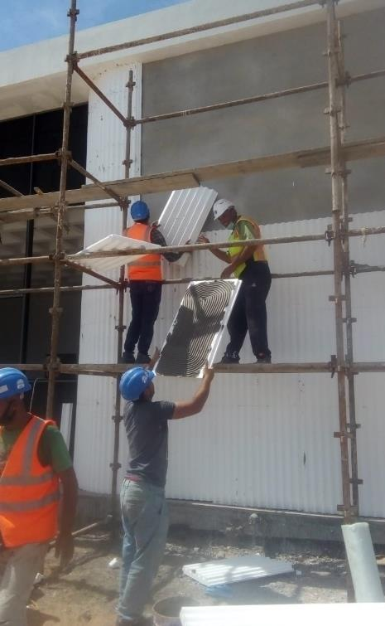

Slide 21
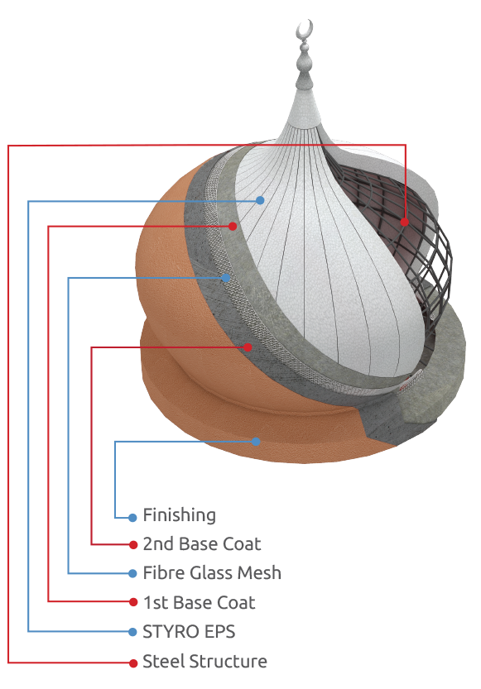
4
STYRO EIFS System
MM (Mix Media)

Slide 22
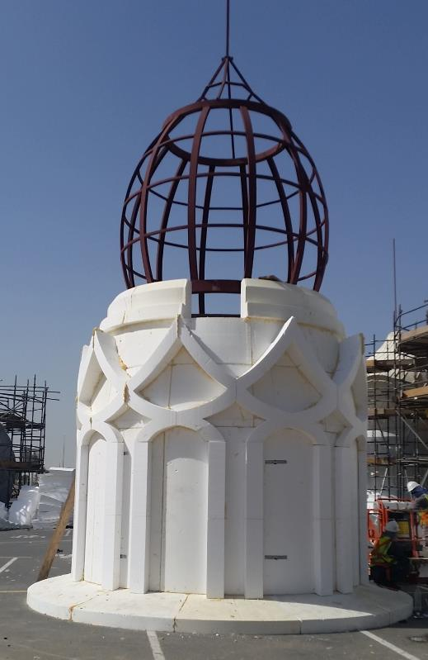
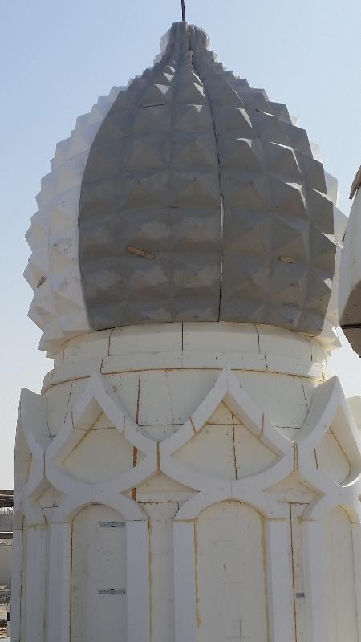
MM (Mix Media) Features:
Lightweight
Unlimited shapes and designs
Stable, Easy and fast to apply
Eco friendly
Easy to handle at site

Slide 23
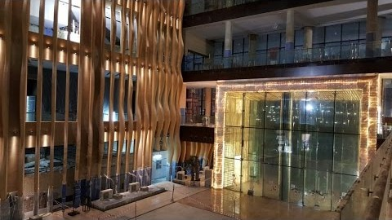
Notes:
Please follow the next tips in order to be able to watch our video:
Open as read-only -> Select (enable content) option -> view it as a slide show

Slide 24
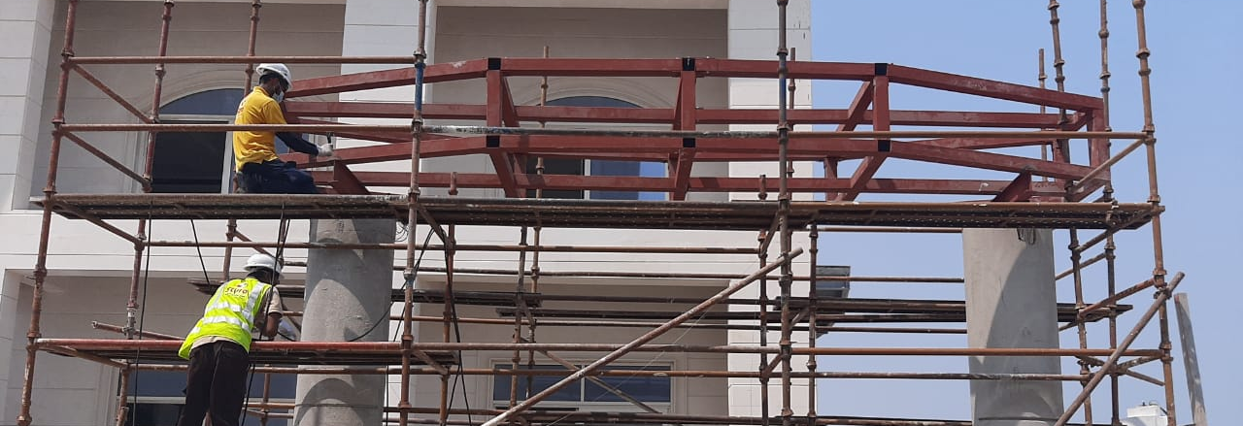
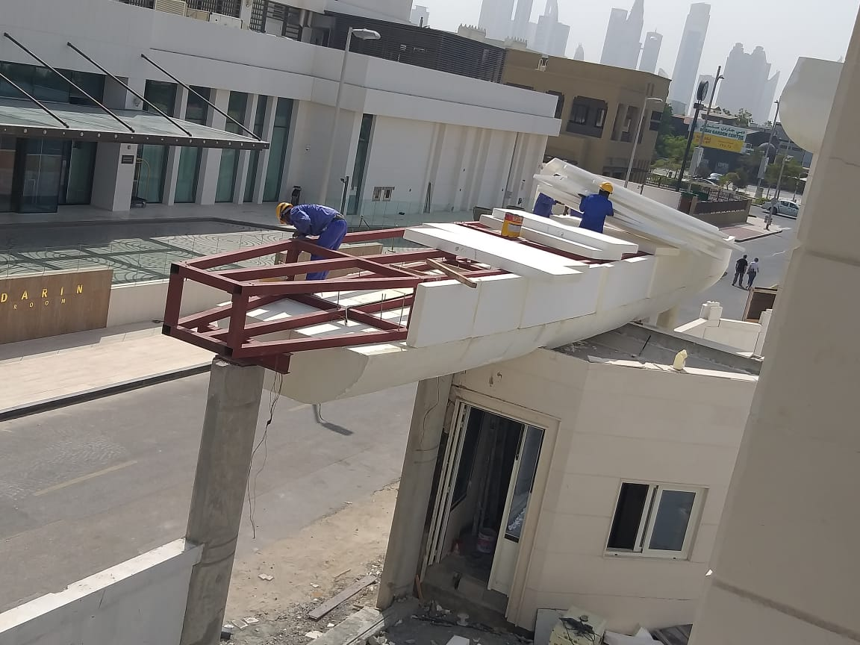
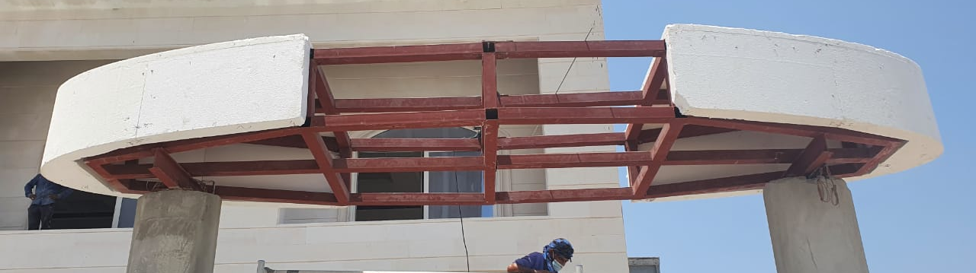
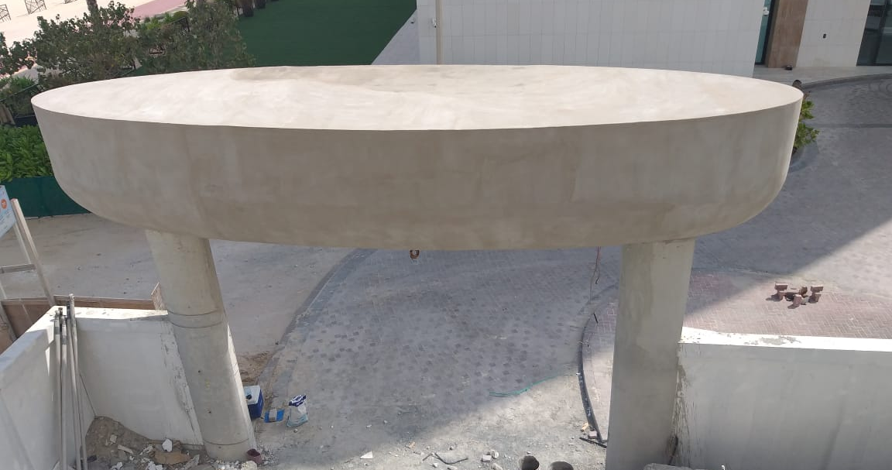
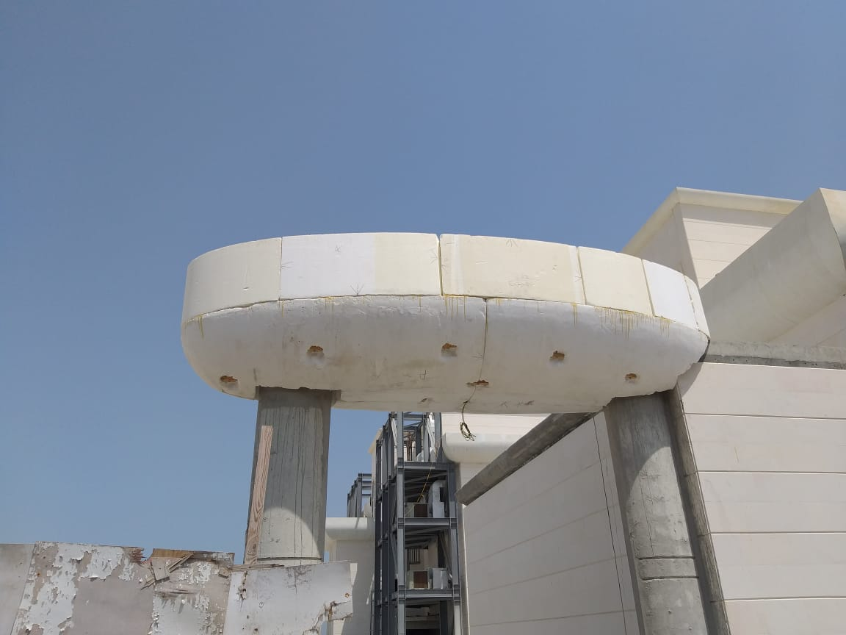

Slide 25
Thank You!

